Slide 1


WELCOME
Group-03
Employee Management System
Data Structure & Algorithm
Section - 07
Lecturer:
Dr. Ruhaidah Binti Samsudin

Slide 2


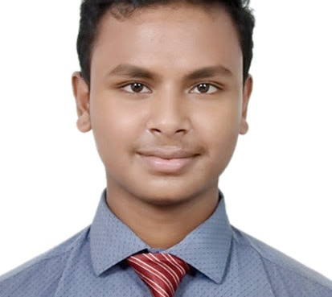
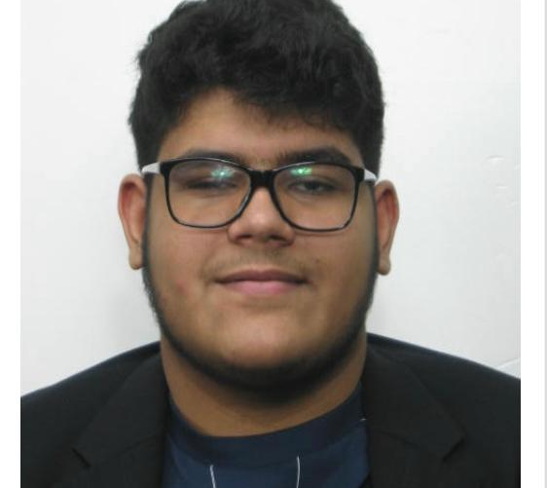
Our Team
Adib Nasir Khan
Md Mostafizur Rahman
Student
A17CS5320 adibkhan193@gmail.com 01139792724
A18CS4030
mostafizur34@graduate.utm.my
+601111146593
• Youssef Mohamed Hamed Abdo
Md Belal Hossain Santo
Student
Student
A17CS5038
belalhossain2@graduate.utm.my
+60187723962
A18CS0334
yousefabdo4777@gmail.com
0196475084

Slide 3
Presentation Topics
In our video presentation we would like to cover up these topics.
INTRODUCTION
CASE STUDY & SOLUTION
01
In this part we will describe about our project backgraound and case studies.
02
In this part we will describe about our project case study and solution.
PROJECT EXPLANATION
FEATURES OF OUR SYSTEM
03
In this part we will describe briefly about our project line by line with explanations.
04
In this part we will discuss about our system’s main features.

Slide 4
01
INTRODUCTION
We aim to make an easy, convenient and effective system, where the admin or owner of a company can manage their employees.
In this system we implement the concept of Linked List, Stack, Search. Here the admin will be able to monitor & manage their employees in a centralized manner.
INTRODUCTION

Slide 5
02
CASE STUDY & SOLUTION
In many existing small & big companies, manual system still prevails. There such organized system can be used to for better company development & growth.
In our program, admin will be able to search any worker by name. He will be able to sack any of their employees if there occurs any employee overflow or the employee reach retirement age.
CASE STUDY

Slide 6
03
LINEAR SEARCH ALGORITHM
We have implemented Linear Search Algorithm in our system. Linear search is a very simple search algorithm. In this type of search, a sequential search is made over all items one by one. Every item is checked and if a match is found then that particular item is returned, otherwise the search continues till the end of the data collection.
PROBLEM STATEMENT

Slide 7
SYSTEM TOOLS / LANGUAGE
Stack
Pop
Push
Display
Linked List ❖ Delete ❖ Push
❖ Display ❖ Search
TOOLS
Linear Search Algorithm
Inheritance
Generalisation
Editor:
Dev C++

Slide 8

MAIN FEATURES OF THE SYSTEM
We, our team have invested countless hours in this system for the sake of making peoples life easier & comfortable. We tried our best to make the interface minimalistic and user friendly as possible. Some of the features of the system are stated below:
All Employee details
All workers details
Add a worker
Search a worker
Approve Medical Leave
Sack a worker

Slide 9
THANK YOU

